Slide 1
Pizza Shop

Slide 2
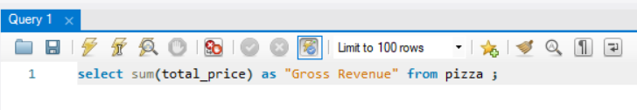

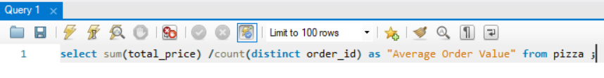
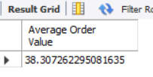
KPI’s
01. Gross Revenue
02. Average Order Value

Slide 3






03. Total Pizza Sold
04. Total orders placed
05. Average pizza sold per order

Slide 4
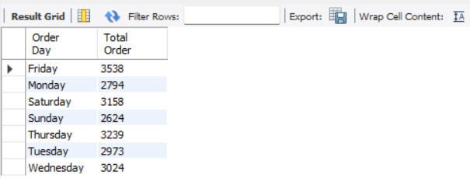
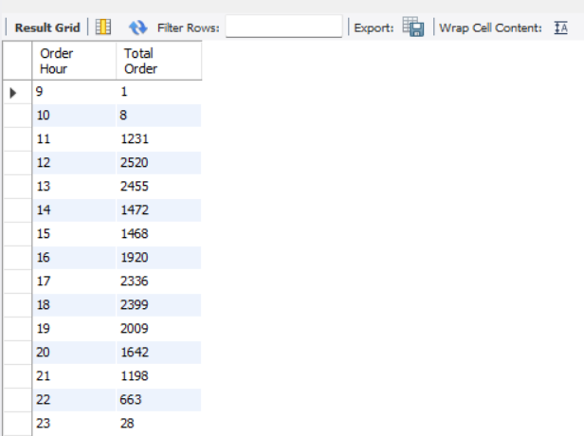
06. Daily trend
Problem: Date in data set was set as text,
and in mysql the default format is yyyy-mm-dd,
So could not even change the format from settings.
Therefore used str_to_date
07. Hourly Trend

Slide 5
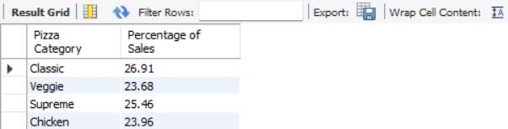
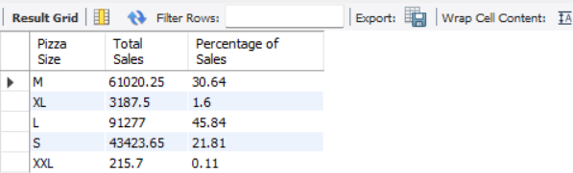
08. Category wise percentage of Sales
Can add where clause to check particular month data
For example: where month(order_date) = 1
This will display January data
(But add where clause to sub query too)
08. Pizza size wise percentage of Sales (4th Quarter)

Slide 6
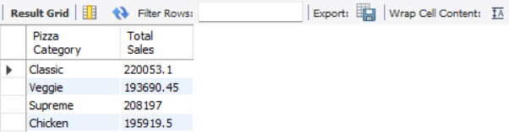
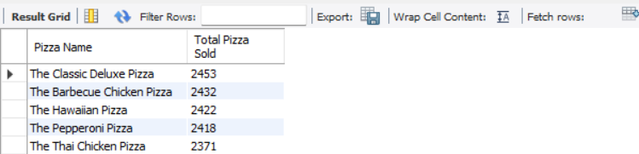
09. Total Pizza Sold by pizza category
10. Top 5 Best seller by total pizza sold
For Worst sellers we can remove ‘desc’

